Slide 1
Day 04
Rigid Body Transformations

Slide 2
Rigid Body Transformations in 3D
{1}
{0}
{2}

Slide 3
Homogeneous Representation
every rigid-body transformation can be represented as a rotation followed by a translation in the same frame
as a 4x4 matrix
where R is a 3x3 rotation matrix and d is a 3x1 translation vector

Slide 4
Homogeneous Representation
in some frame i
points
vectors

Slide 5
Inverse Transformation
the inverse of a transformation undoes the original transformation
if
then

Slide 6
Transform Equations
{2}
{1}
{0}
{4}
{3}

Slide 7
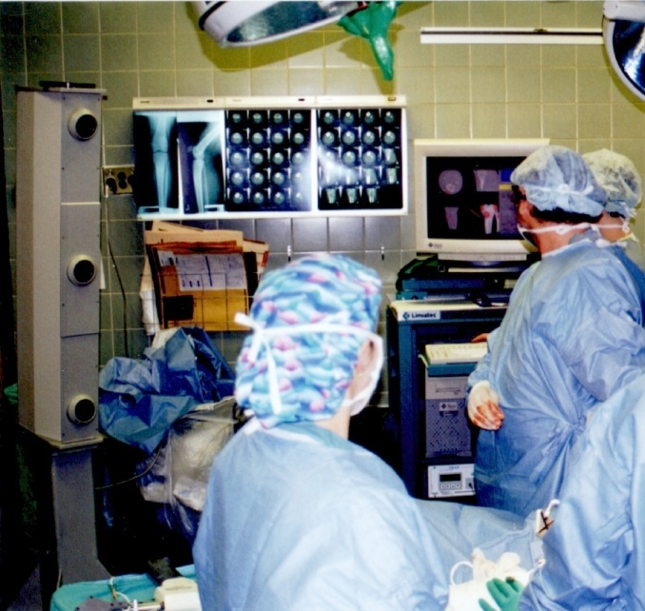
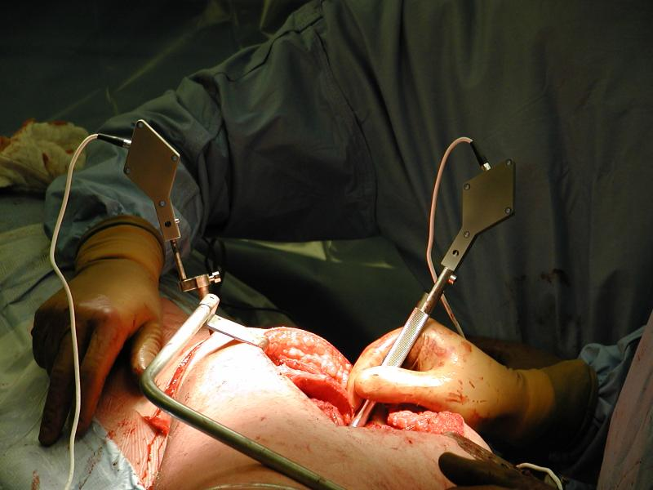
Frames in Computer-Aided Surgery
{P}
{T}
{C}

Slide 8
Frames in Computer-Aided Surgery
{P}
{M}
{T}

Slide 9
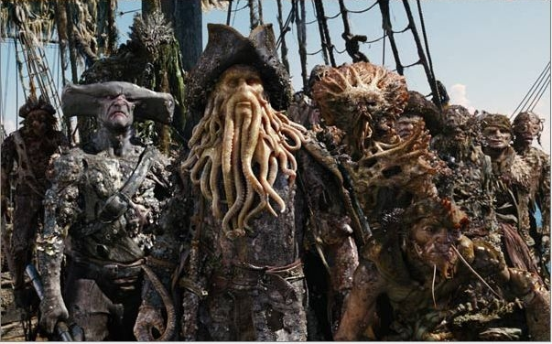
Frames in CGI

Slide 10
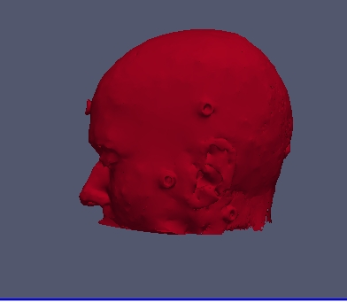
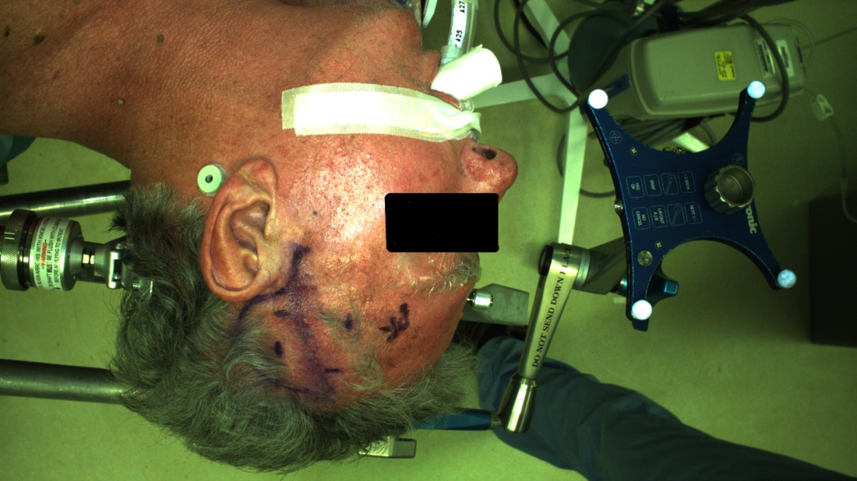
Frames in Computer-Aided Surgery
{P}
{CT }

Slide 11
Fiducial Registration
physical markers easily locatable in the medical imagery and on the patient are often used in neurosurgery to establish the spatial relationship between the patient and the images
same fundamental problem appears in many different fields and goes by many different names
fiducial registration
point-based registration
paired-point registration
registration with correspondances
absolute orientation
point fitting
...

Slide 12
Problem Statement
given n points measured in {L} and {R} estimate the transformation (or )
{L}
{R}

